Slide 1
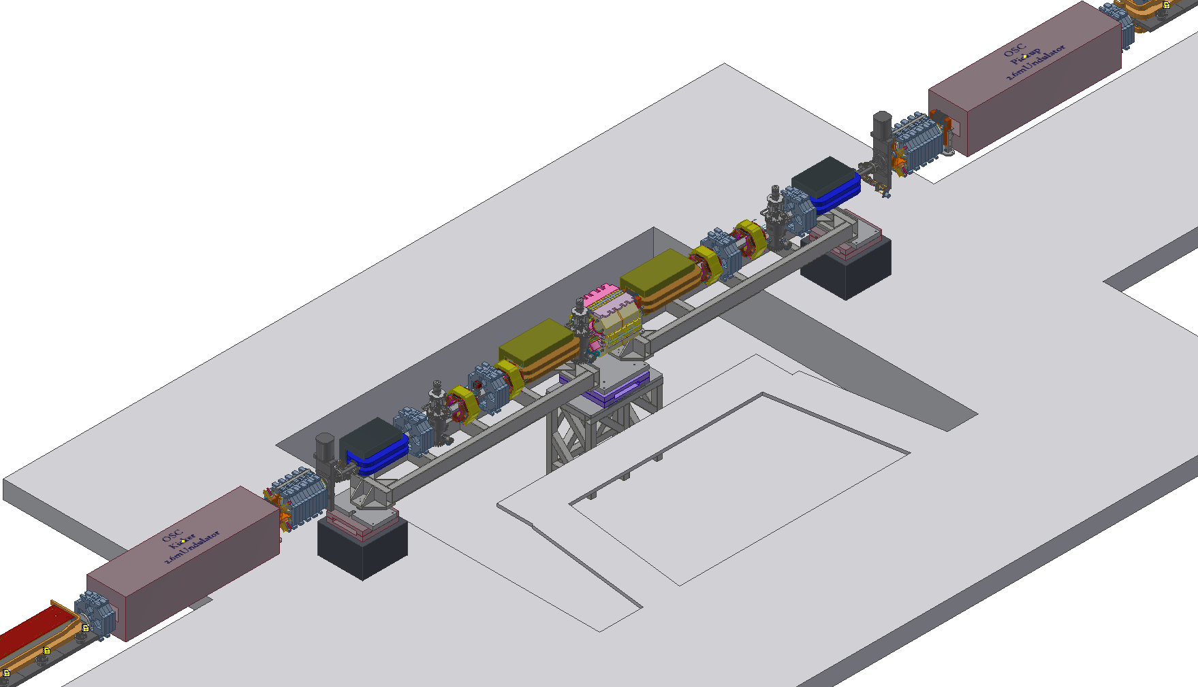
OSC Layout 8/29/2018 Mixed 0.65m & 0.85m
Bend Magnets

Slide 2
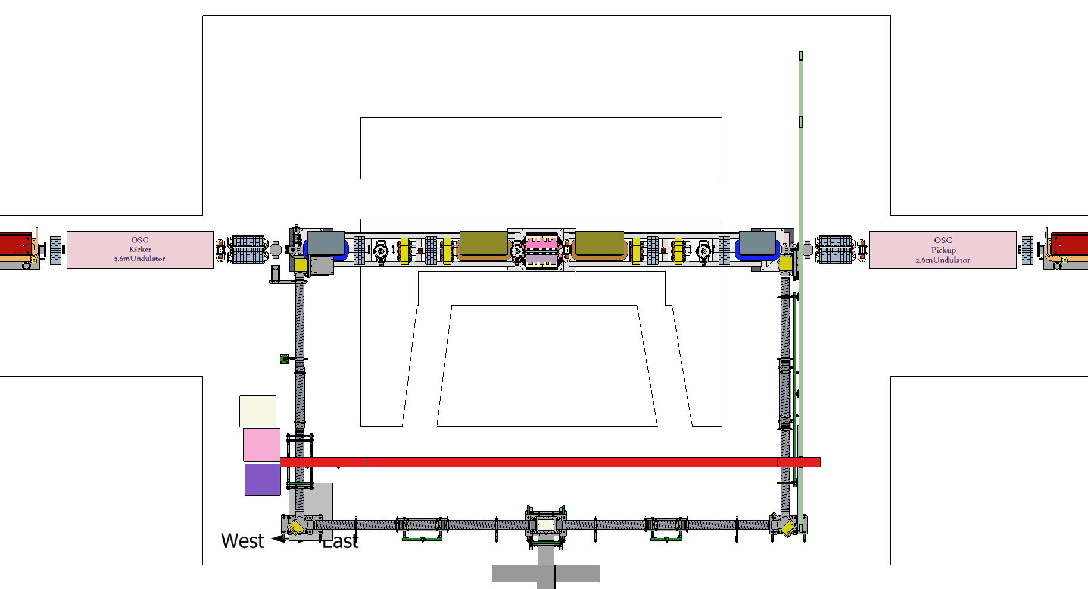
OSC Layout 8/29/2018 Mixed 0.65m & 0.85m
Bend Magnets
0.65m Bend Magnet
0.65m Bend Magnet
0.85m Bend Magnets
Vertical
Steering + BPM
Center
Optics Chamber

Slide 4
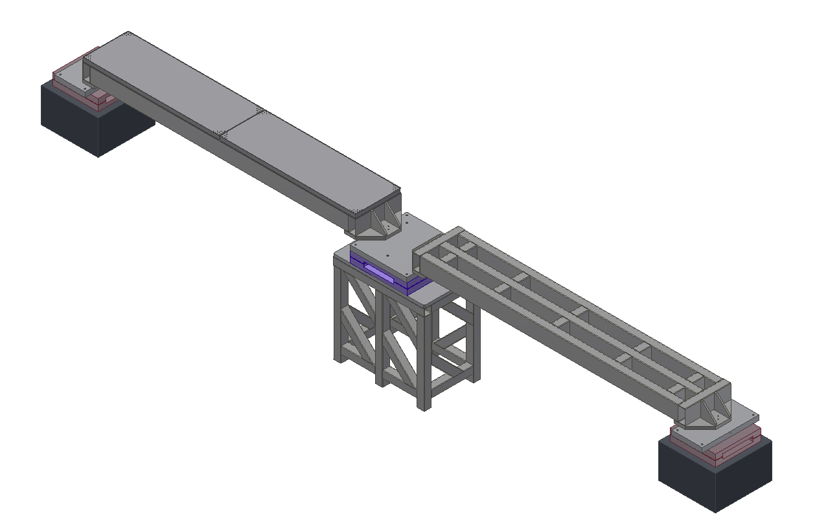
Tapered
Roller Bearings
Tapered
Roller Bearings
15 cm travel
Newport Optical Breadboard
Granite Block
30” x 30” x 18”
~1600 lbs
On 4x Leveling Wedges
East
Girder
West
Girder
ADC Custom
Crossed Roller Bearing
Linear Stage
6” (15cm) Travel
Linear Guide

Slide 5
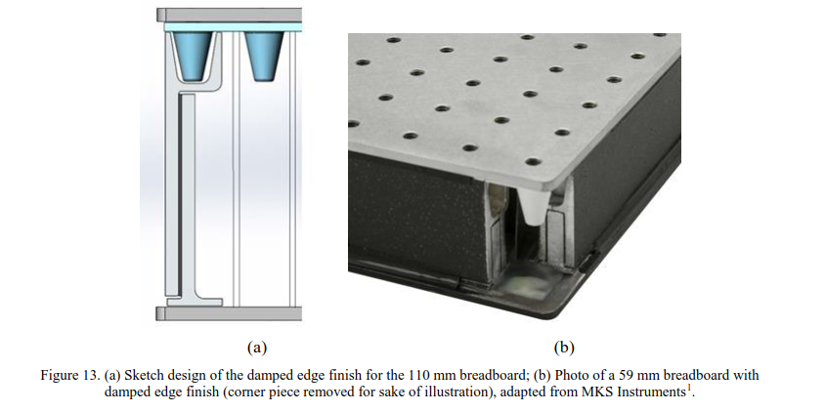
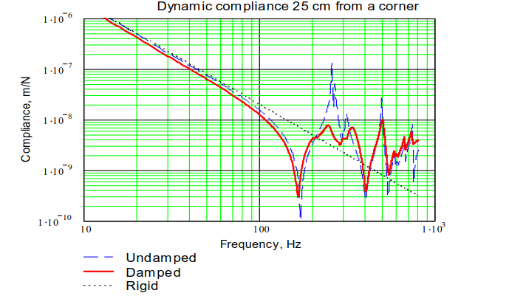
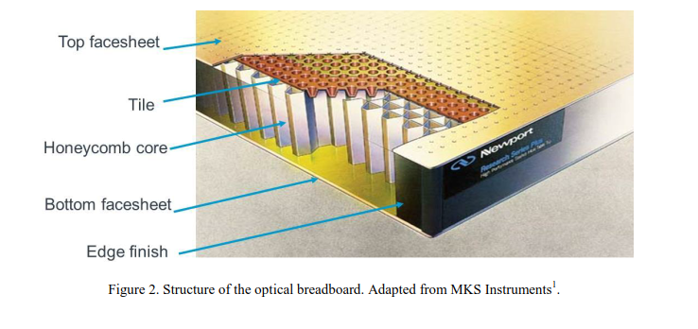
Damping treatment of optical breadboards
V. Ryaboy 9/2017

